Slide 1
Windows 10 Development Readiness
Joseph Reynolds, Principal Software Engineer

Slide 2


Joseph Reynolds
Principal Software Engineer Clear Measure, Inc
Lonestar College IT Advisory Board Chair, 2010 – present
North Houston .Net User Group Board Member, 2011 – present
Microsoft .Net MVP 2013 – present
Enjoys reading, playing games, and spending time with family.

Slide 3
Agenda
A single platform
One Windows
Many devices
Developer experience
Windows tooling
.Net Native
Template 10
http://aka.ms/template10

Slide 4
Introducing the UWP
Universal Windows Platform

Slide 5
Windows Core
The refactored common core
One hardware platform
Universal hardware driver
Standard network and I/O
Desktop SKU
Phone SKU
Xbox SKU
Windows Core
Desktop
Device
Phone
Device
Xbox
Device

Slide 6
One Windows
Desktop SKU
Mobile SKU
Xbox SKU
IoT SKU
IoT headless SKU
Surface Hub SKU
Holographic SKU
PC
2 in 1
Tablet
Phablet
Phone
Xbox
Band
Raspberry Pi
Surface Hub
HoloLens
Home Automation

Slide 7
Each family adds features to the one it inherits

Slide 8

The convergence journey
Xbox 360
Xbox One
Unified core and app platform
Converged
OS kernel
Windows 8.1
Windows 8
Converged
app model
Windows 10
Windows Phone 8.1
Windows Phone 8
Easy for users to get & stay current
Windows Phone 7.5
Windows on Devices
Notes:
Microsoft has been working to converge its client operating system and developer platforms for a long time.
In Windows Phone 7, the operating system was based on Windows CE, a great operating system for small, handheld devices, but different from the OS on ‘big’ Windows. When Windows Phone 8 was launched, we swapped out Windows CE and base it on the Windows NT kernel instead, same as our PCs. We did a similar thing with Xbox One.
But it wasn’t until Windows 8.1/Windows Phone 8.1 that we really delivered on a converged developer platform. You can build universal 8.1 apps that share a very high percentage of code and where you program against the same APIs.
With Windows 10, we’ve taken that even further and for the first time allow developers to create a single app that can run across all devices running Windows 10. Windows 10 brings developers a unified core OS across all devices and a single app platform.

Slide 9
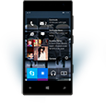

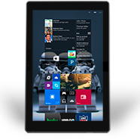
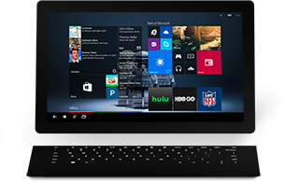

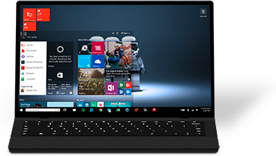

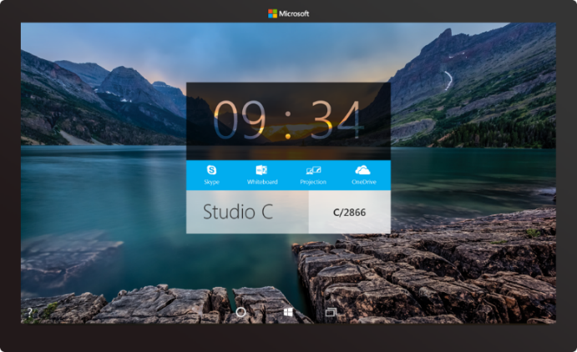

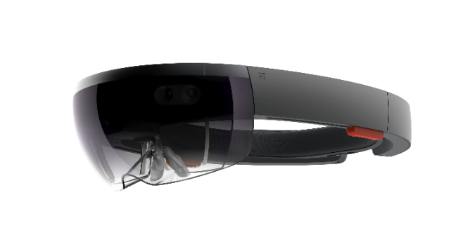



2-in-1s (Tablet or Laptop)
Classic Laptop
Desktops & All-in-Ones
Phone
Phablet
Small Tablet
Large Tablet
Windows 10
Surface Hub
Xbox
Holographic
IoT
Notes:
Windows 10 runs on a wide variety of devices, from phones with a 4.5” screen, through phablets, tablets, PCs, laptops, convertibles such as the Surface, on desktops and All-in-ones, to the Xbox in your living room and right up to giant 84” screens such as our team collaboration device, the Surface Hub. And it also takes in very tiny cheap computers such as the Raspberry Pi 2, and innovative hardware such as the Hololens.

Slide 10
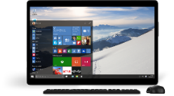
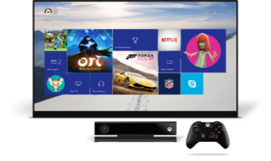
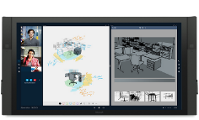
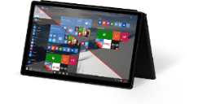
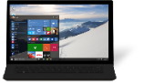

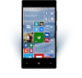
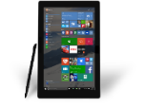
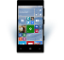











PC
XBox
Mobile
Surface Hub
Devices +IoT
HoloLens
Universal Windows Apps
Multiple device families
Adaptive User Interface
Reuse Existing Code
Natural User Inputs
One Store + One Dev Center
One SDK + Tooling
One Universal Windows Platform
Notes:
We’ve divided this broad range of hardware into different device families – as developers you will likely build apps that target one or more device families.
<click>
We have small devices and IoT, phones and small tablets are in the Mobile device family, large tablets and PCs in the PC (or as we more usually call it, Desktop) family, the Xbox, Surface Hub (or ‘Team’) and finally the Hololens
<click>
And all of these device families run the same developer platform – the Universal Windows Platform. You can build a single app that can run across all these device families using a single SDK and distribute apps through a single store.
Of course, with this diversity of devices, what we are *not* saying is that you should create one app that kind of works adequately across all these devices. No, we want you to create apps that shine on each device family, so we’ve added APIs, controls and tools to help you build an adaptive UI.

Slide 11
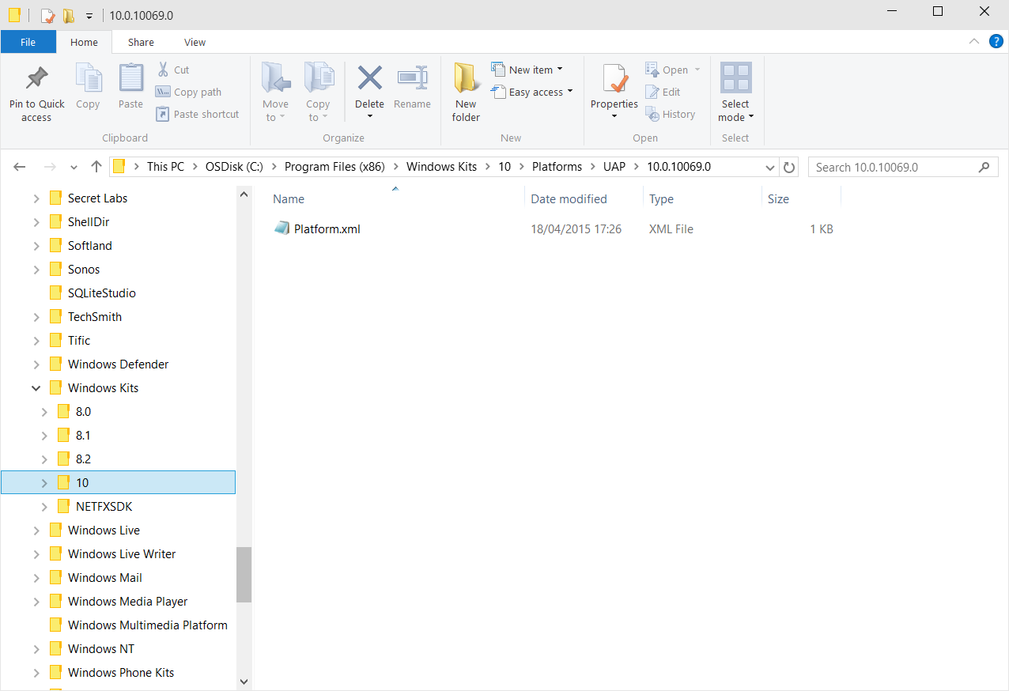
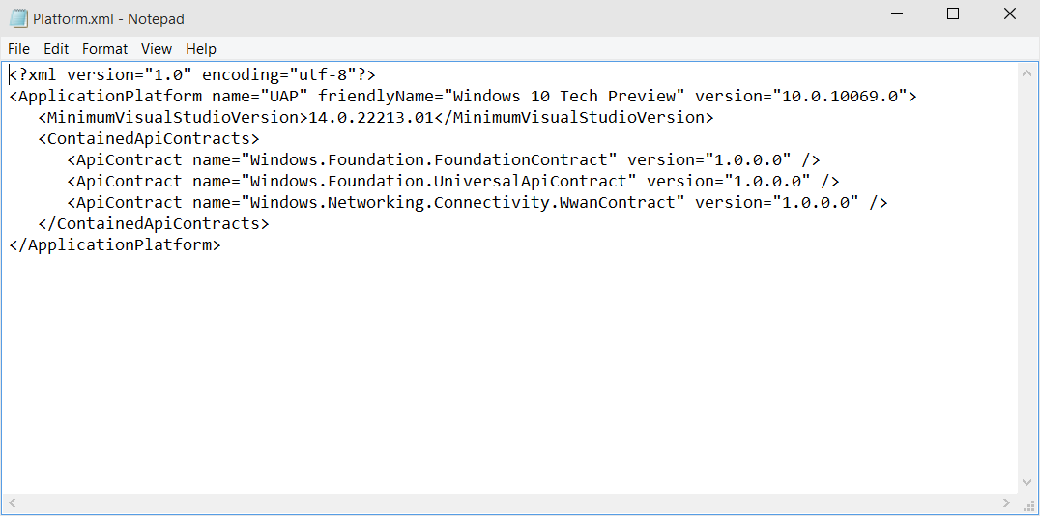
Universal Windows Platform
A single API surface
A guaranteed API surface
The same on all devices
Universal Windows Platform
Windows Core
Desktop
Device
Phone
Device
Xbox
Device
Notes:
So, what is the Universal Windows Platform?
It’s a single API surface that is consistent across all Windows 10 devices.
This guaranteed API surface is what enables developers to build a single app that can run across all devices.
What we’ve done is taken the Windows Runtime APIs that we first launched with Windows 8, massively expanded it and we’ve also componentized it, dividing it into a number of ‘contracts’.
Why ‘contract’? – Because these components provide a contract between the platform and you, the developer, that a certain major version of a contract will offer a guaranteed API surface and behaviors, even through many minor revisions. It allows us to innovate and enhance the platform by releasing updated components exposing new capabilities and allows you to develop apps against a versioned API.

Slide 12
A whole lot of APIs…
Storage
DirectX 12
Speech and Cortana
Networking
NFC and Bluetooth
Holographic
Audio and Video
Appointments/Calendar
Authentication Broker
Background Transfer
Maps and Location
Sensors: Accelerometer, light, magnet …
Tiles and Notifications
App to App and App Services
Inking
XAML
Background Tasks
Data Roaming
Data.XML
Media Casting
Many, many more….
Notes:
And it’s a big API!
Here’s just a sample of some of the feature areas that UWP APIs cover.
As you build apps against the UWP, you will find that the vast majority of the things you want to enable can be achieved by APIs that are in the UWP – and therefore available across all Windows 10 devices. We do have a way of calling device family-specific APIs, and we’ll come onto that shortly. But most of what you need can be found in the UWP.

Slide 13
Apps don't target Windows 10, apps target the UWP
Notes:
Don’t care about “version” of windows
Care about the Platform
Are the APIs guaranteed?
Platform can update as fast or slow as needed
And this is a subtle change in your thinking as an app developer: you’re not building apps against an OS – Windows 10 – you’re building apps against the Universal Windows Platform, which is serviced and is updated independently of the OS.

Slide 14
<Dependencies>
<TargetDeviceFamily
Name="Windows.Universal"
MinVersion="10.0.10240.0"
MaxVersionTested="10.5.0.0"/>
</Dependencies>
Notes:
In your application’s Package Manifest, you will have a declaration such as this.
What this says is that this app was built against UWP version 10.0.10240.0 (the first version that went on GA - General Availability). When you create your first UWP apps, the MaxVersionTested will also be set to 10.0.10240.0, but imagine a time in the future, when newer versions of the UWP have been released to install side by side with earlier versions.
If you the developer have tested this app on UWP version 10.5.0.0, you can declare this in the manifest. What this then says is that this app package will run just great on 10.5.0.0. It doesn’t mean it cannot run on later versions, just that if it does, then the runtime should enforce version 10.5.0.0 behaviors.
The Windows Store uses this information to ensure the best available version of an app package gets deployed to target machines.

Slide 15
The Universal Windows Platform can update at its own cadence
Notes:
The old days of 3 year OS engineering cycles, at the end of which we release a big new version of Windows, or a major Service Pack – those days are gone. Instead, Windows 10 is more of OS platform that is ‘Windows as a Service’ – a continuously serviced, continuously improved, continuously enhanced operating system.
And the UWP is the guaranteed API surface that you build apps against. It too is continuously enhanced and new versions will be released at regular intervals, but it has its own update cadence that is independent of the OS.

Slide 16
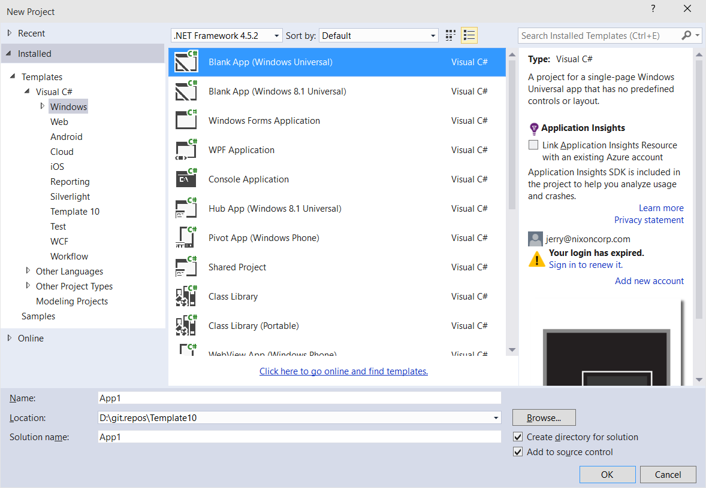
Windows app
A single binary
Running on any device
Testing for capabilities
Adjusting to devices
Windows App
Universal Windows Platform
Windows Core
Desktop
Device
Phone
Device
Xbox
Device
Notes:
So, on top of the UWP, you build your universal Windows app.
Unlike in Windows 8.1, where a universal 8.1 app creates separate binaries for PC and for Phone, with UWP it truly is a single app package that can run on any UWP device.
The runtime on each device family is able to run UWP apps whatever the device.

Slide 17
Hello devices
Notes:
See demo notes on github

Slide 18
TODO
Add some screen shots in case demo doesn’t work

Slide 19
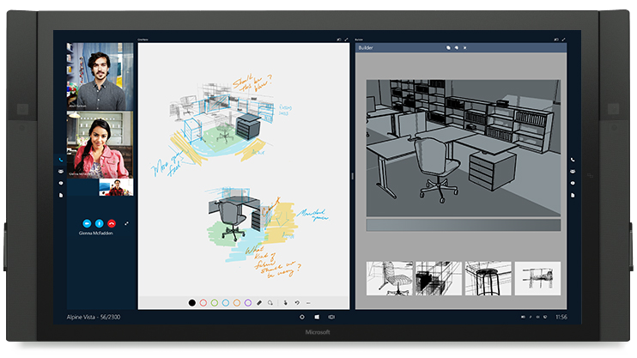

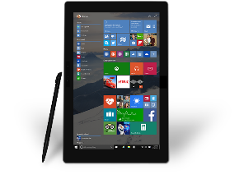

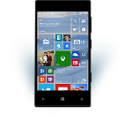

Universal Windows Platform
One Operating System
One Windows core for all devices
One App Platform
Apps run across every family
One Dev Center
Single submission flow and dashboard
One Store
Global reach, local monetization Consumers, Business & Education
Notes:
Windows 10 offers an unprecedented opportunity for developers: the same core operating system across all Windows 10 devices, a common app platform, a single dev center where the developer can manage their app submissions for all Windows 10 devices, and a single Windows Store for app deployment, including special access for Businesses and Education.

Slide 20
One Windows
Desktop SKU
Mobile SKU
Xbox SKU
IoT SKU
IoT headless SKU
Surface Hub SKU
Holographic SKU
PC
2 in 1
Tablet
Phablet
Phone
Xbox
Band
Raspberry Pi
Surface Hub
HoloLens
Home Automation
Notes:
Let’s take a look again at the device families. As we said before, we are dividing Windows 10 into broad groupings of similar devices, called device families.
And while all these device families offer a distinctive user experience to the end user, they all run the same app platform so you can create apps that run across a broad range of these device families.
This commonality is a strength – but what we are *not* saying is that you have to create some kind of ‘lowest common denominator’ app that works adequately across devices. We want you to create apps that shine on each device and offer the best possible user experience to end-users of your app.

Slide 21
Each family offers its own shell and adds features to those it inherits
Notes:
If you think about the primary user interface of each device family – the Windows shell – each device family offers its own user experience that is appropriate for that device. Each device family also has its own distinctive features that create a great user experience for users of that device. There are also a small number of APIs specific to each device family that you can call to create differentiating experiences on each device – we’ll come onto that in a short while.

Slide 22
Adaptive UI
Notes:
But before talking about the device family specific APIs, let’s talk about adaptive UI – how you can create a great UI for your app that adapts to whichever screen size and orientation it is running on.

Slide 23
Adaptive design
Responsive design
Flexible layout responds to small changes
Many controls handle basic responsiveness
Adaptive design
Smart layout adjusts to large changes
Features like visual states aid in this design
Tailored design
A device-specific app can simplify design
Some devices have unique design languages
Notes:
When you are thinking of adaptive design, you want to build your page layouts using responsive design techniques – so no fixed widths, but instead having content that flows and can automatically adjust to relatively minor changes, such as the difference I screen size between a 4.5” screen and a 5” screen.
Many of the built-in controls have basic responsiveness built in. So they know when the user is using mouse & keyboard, and when they are using touch, and modify their layout accordingly, displaying larger hit areas for touch.
But you will also need to adjust your page layouts for big changes, such as the difference in screen size between a phone and a PC. Here, features such as Visual States can be a great help.
And you may also want to employ tailored design techniques, where instead of retaining the same basic page content and adjusting layout for different screens, you create a tailored experience that is more appropriate to the device and the way the user is likely to want to interact with it.

Slide 24
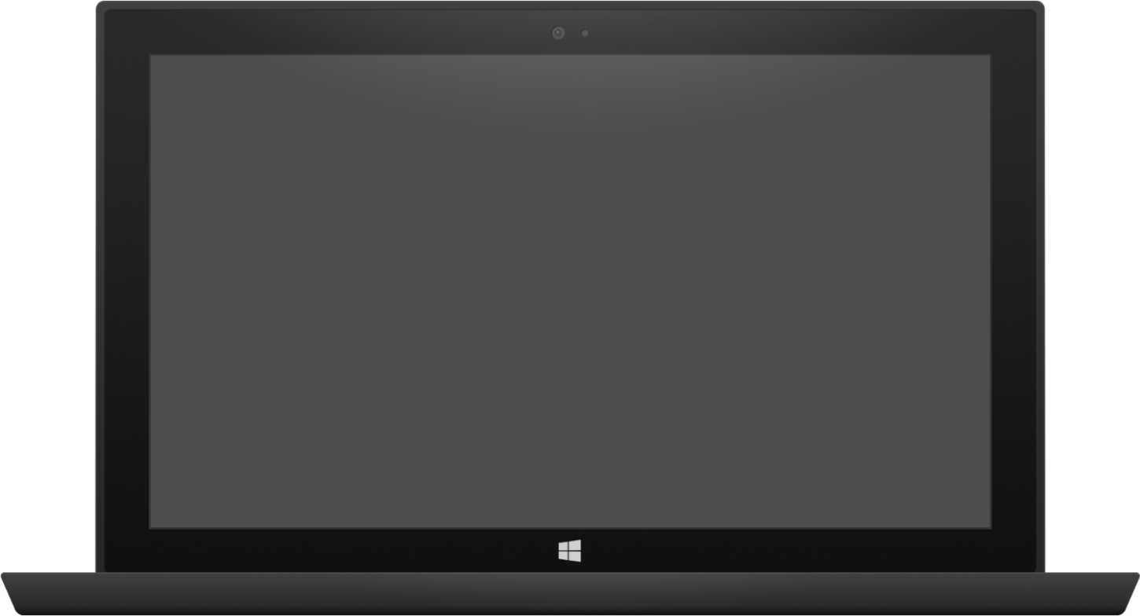

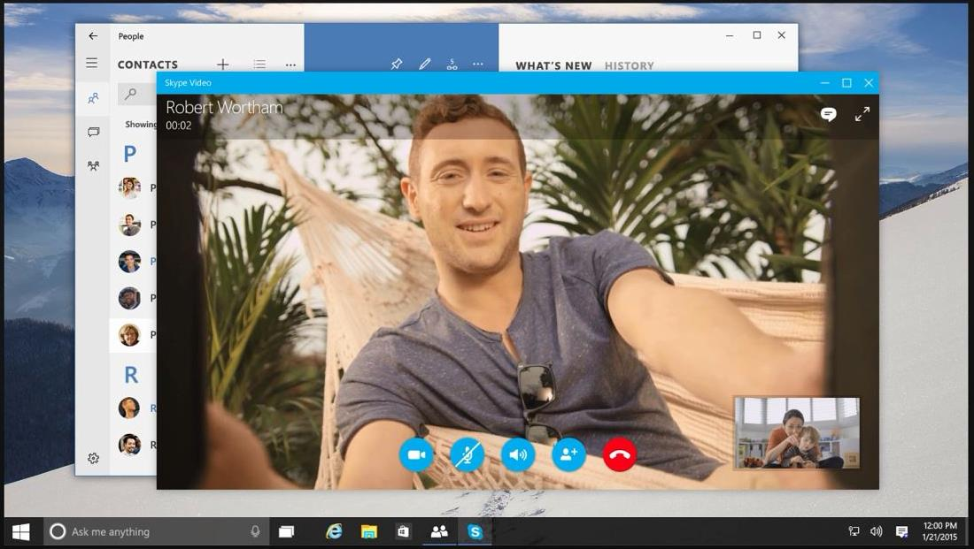

Adaptive design
Tablet (landscape) / Desktop
Phone (portrait)
Notes:
Here is an example of responsive design:
On the large screen on the right, we take full advantage of the size of the window the app is running in, we lay out the control buttons in a line, and we place the thumbnail of the people making the call off to the right.
On the small phone screen, it’s essentially the same, but the image is cropped, and the large red End Call button has been placed underneath the other buttons, while the thumbnail moves up the page to just above the call control buttons.

Slide 25
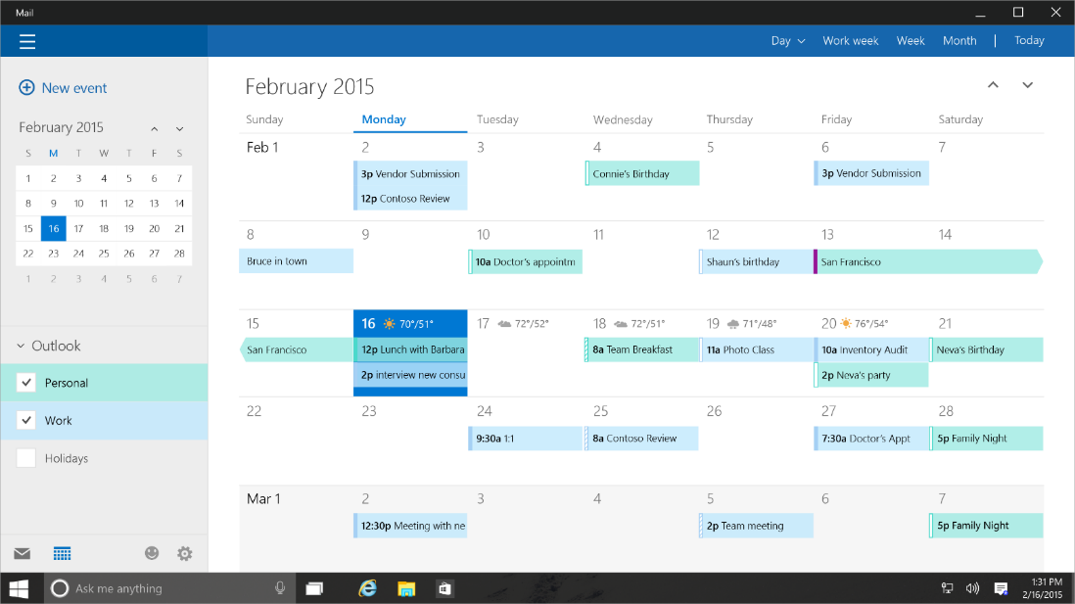
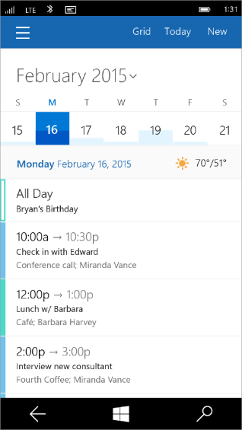
Tailored design
Tablet (landscape) / Desktop
Phone (portrait)
Notes:
Adaptive controls are great, and responsive layout will get you a long way, but we know there will be cases where the app designer wants to do something more custom or more tailored than the adaptive controls will allow.
This desire might be motivated by hardware differences. For example, an app that will run on an Xbox might want to create some customizations for navigation using a game controller.
Or it might be motivated by screen size and usability. A designer might want to position a menu at the bottom of a phone screen to make it more usable with a single hand.
For these cases, we enable developers to create what we call a tailored user experience. In this case, the code is the same, but the developer creates custom XAML to deliver the desired design on the right device or in the right set of conditions.
Tailored design goes beyond Adaptive UX
Developers can create custom experiences for certain devices
The code is the same, but custom XAML can deliver the experience a developer wants

Slide 26
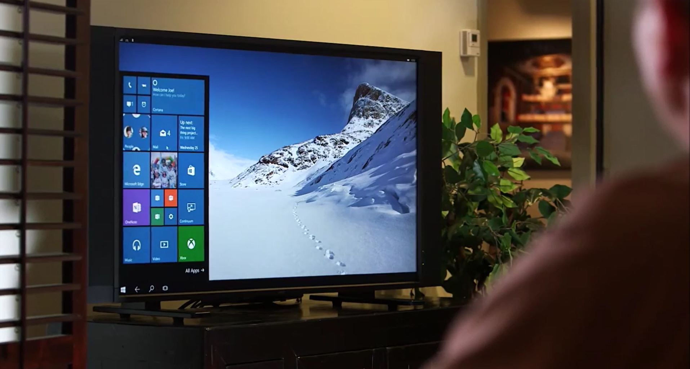
Continuum for Convertibles and Phones
Continuum for convertibles and Phones
Notes:
Every Windows 10 app designer needs to think about adaptive UI and how their app will appear on different screens. Even if you start out by thinking of an app that you only want to release on Phone, so you think only of screen layouts appropriate for phone screens, well your app can still end up running on a big screen.
The exciting Continuum feature is coming to Windows Phone, where the new generation of phones can be connected to an external screen and a Bluetooth keyboard and mouse and can be used just like a full PC! So all of a sudden, your app designed for phone can be running on a big monitor. You will want to ensure that the user experience in that case is a great one!

Slide 27
Users love apps that give a great experience on all their devices
Notes:
Many users of mobile devices these days carry around two or more different computing devices. And they will want to use their favorite apps on their phone, their tablet, their convertible and their desktop machines.
The apps that will get the best ratings will be those that give a great user experience on all the users’ devices!

Slide 28
Adaptive code
Notes:
Adapting the UI to different screens is the major part of creating an app that works across different device families, but you may also want to call device family-specific APIs to create unique experiences on different devices.
You can do this using something we call ‘Adaptive code’.

Slide 29
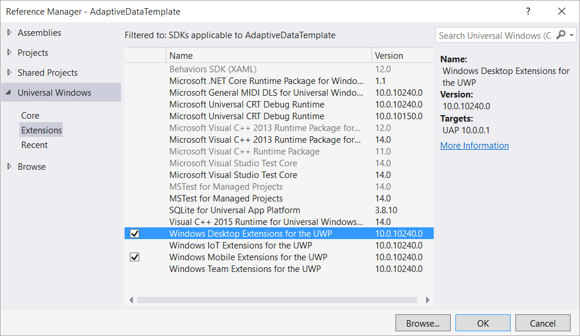
Platform extensions
Windows App
Device-specific API
Family-specific capabilities
Compatible across devices
Unique update cadence
Desktop
extension
Phone
extension
Xbox
extension
Universal Windows Platform
Windows Core
Desktop
Device
Phone
Device
Xbox
Device
Notes:
Although the majority of the APIs you need for a UWP app are in the common API set, we also make available device family-specific APIs. We release these as Platform Extension SDKs. You can add a reference to these extension SDKsin exactly the same way as any other reference library.
Like the UWP itself, these extension SDKs are versioned and may be released and updated independently of the UWP and the OS.

Slide 30
Platform extensions don't invalidate binaries on other devices
Notes:
The most important thing to realize about extension SDKs is that when you reference the extension SDK for a particular device family, you are not limiting the app to now be able to run only on that device family. When you package the app and distribute it, it can still run across a broad range of device families.
There are ways of limiting distribution of your app during the app submission process to the Store, but adding a reference to an extension SDK is not a part of that process.

Slide 31
UWP
UWP
UWP
UWP
Windows Core
Windows Core
Windows Core
Windows Core
Desktop
Mobile
Xbox
More…
Notes:
This diagram illustrates how it works:
<Click> Each device family runs the same core OS
<Click> Your app is built upon the UWP and that is common across all device families.
<Click> When you add a reference to an extension SDK, you are making those APIs available to be called by your application code – but those APIs are only usable at runtime on the matching device family
<Click> Although, when you add a reference to an extension SDK, the metadata for those APIs are loaded into your project, so the C# compiler and Visual Studio Intellisense works correctly when you reference those APIs during the app development process.

Slide 32
Test capabilities at runtime
Use Adaptive Code to light-up our app with capabilities on specific device families
Testing for capabilities and namespaces
var api = "Windows.Phone.UI.Input.HardwareButtons";
if (Windows.Foundation.Metadata.ApiInformation.IsTypePresent(api))
{
Windows.Phone.UI.Input.HardwareButtons.CameraPressed += CameraButtonPressed;
}
Notes:
So, we’ve got these device family-specific APIs that your app code can use, but they are only usable at runtime on specific device families. How do we make sure these APIs are called only at the appropriate time?
The answer is to ‘gate’ calls to any API in an extension SDK with runtime checks to verify that a particular API is available to use. You do this using methods of the Windows.Foundation.Metadata.ApiInformation API. The most common method to use is IsTypePresent() which is a runtime check that the named API is actually loaded and usable wherever the app happens to be running.

Slide 33
Microsoft Edge and Web Platform

Slide 34

Microsoft EdgeHTML
Microsoft Edge
JS Symbols
ES6 Numbers Built-Ins
DOM L3 XPath
Rest parameters
4200+ interoperability improvements
ES6 Template Strings
Arrow function
asm.js
JS iterators
<img srcset>
Web Audio API
ES6 classes
GamePad API
Content Security Policy
Video tracks
ES6 Promises
Selection API
ES6 Math Built-Ins
HTTP Strict Transport Security
Touch Events
Media Queries L4 Interaction Media
ES6 String Built-Ins
ES6 WeakSet
getUserMedia()
ES6 Spread
preserve-3d
ES6 Proxies
ES6 Object Built-Ins
HTTP/2
WAV audio
HTTP Live Streaming
Date <input> types
Motion JPEG
Generators
Notes:
Windows 10 has a lot to offer web developers, as well !
First, there’s a new web rendering engine – Microsoft EdgeHTML – that’s built for the modern web.
<click>
It powers both the new Microsoft Edge browser as well as web content in Universal Windows apps.
<click>
Edge leaves behind all of the Internet Explorer specific behaviors that had been built up over the last 20 years
And has over 4,200 interoperability improvements to ensure that the web just works.
For developers, this means less time fixing up your web apps to work across browsers.
EdgeHTML also features over 45 new web standards, including:
HTTP/2
Web Audio
And a bunch more that you can see here.

Slide 35
Microsoft Edge
Microsoft Edge
.NET & Win32
Android
iOS
Notes:
While improving interoperability and adding new features to EdgeHTML, we didn’t forget to pay attention to performance.
Here is how EdgeHTML performs on two leading web benchmarks:
<click>
On the JetStream benchmark created by Apple, which simulates complex web applications, EdgeHTML is over 1.5x faster than IE11.
<click>
Beyond that, it is also ahead of the latest 64-bit browsers.

Slide 36
Microsoft Edge
Microsoft Edge
.NET & Win32
Android
iOS
Notes:
Next on the Octane benchmark, created by Google, Edge is over twice as fast as IE11
<click>
And again, Edge, leapfrogs into the lead ahead of other 64-bit browsers.
Our work is not done, but we feel great that Edge will provide industry leading performance out of the gate.

Slide 37
Bridging Technologies
Notes:
The Universal Windows Platform (UWP) is a single app platform that is available across all Windows device families, enabling you to reach a new user base and open up new revenue opportunities. From PCs to tablets, phones, Surface Hub, and Raspberry Pi and soon to include Xbox, and HoloLens – you can reach all these devices and look great on them all using one store and one codebase.
Following the launch of Windows 10, we are also releasing four Windows Bridge toolkits that enable you to quickly bring your existing code base to the Universal Windows Platform and add capabilities such as live tiles, active notifications, and Windows Store in-app purchases. Each toolkit provides you with tools and run-time technologies that are tailored for your codebase.

Slide 38
Web Apps
pp
NEW: Hosted Web Apps
Bring your website experience to the Windows Store
Leverage your web investments and developer workflow
Full access to Universal APIs, including
Tiles, Notifications, Camera, Contact List, Calendar
.appx
HTML
CSS
JS
Universal Windows Platform
Notes:
First up is Hosted Web Apps.
Beyond making the web run great in the browser itself, Windows 10 provides a powerful new path for sites to become apps.
<click>
With Windows 10, you can re-use your existing web site code and create an app that points directly to your URL.
You don’t need to re-write your server code into packaged client code!
<click>
You can access Universal Windows Platform APIs directly from the web code that came down from your server.
<click>
And you can distribute the app you’ve made in the Windows Store.
This new path is fully integrated into your existing web workflow.
You can continue to use the same tools, libraries, and services you use today.
You can continue to deploy to your servers to make updates.

Slide 39
Windows Bridge for Android (a.k.a. Project Astoria)
Tooling to allow apps written for Android™ to run on Windows 10 Mobile with few changes required
Microsoft Interoperability library redirects calls to Google services to Microsoft services
Submit .apk to the Store
Extend to call subset of UWP APIs
Tiles and Notifications
Sign up for limited developer preview at http://uwp.dev.windows.com/en-US/uwp-bridges/android
Notes:
For existing Android™ developers, the Windows Bridge for Android will enable you to build apps using Android code to target Windows 10 phones and small tablets without having to leave your Android IDE.
In addition to extending the IDE, the Windows Bridge for Android will include a Windows phone emulator and interop capabilities that help your app (including UI and services) to run and look great on the Windows platform.

Slide 40
Windows Bridge for iOS (previously known as ‘Project Islandwood’)
Build Universal Windows Apps using Objective-C
Import Xcode® projects into Visual Studio
Build and debug your Objective-C code from Visual Studio
Take advantage of great Windows services
Extend your app to take advantage of Universal Windows Platform features
Get the Developer Preview:
https://dev.windows.com/en-us/uwp-bridges/ios
Code is open source:
https://github.com/Microsoft/WinObjC/
Notes:
For existing iOS® developers, the Windows Bridge for iOS will enable you to build a UWP app from within Visual Studio 2015 using your existing Objective-C® code.
You will be able to import your Xcode® project into Visual Studio, tailor the app experience to run on each Windows device family, and extend your iOS code to take advantage of UWP capabilities.
Why the bridge is not a port:
Our goal with the iOS bridge has never been simply to run iOS apps on Windows. Rather, our goal is to help you write great Windows apps that use as much of your existing code and knowledge as possible. We will, of course, continue to work to expand our iOS compatibility, but it’s important to note that there is much more you can do with the bridge.
Behind this goal are three core principles that drove the architecture and design of the bridge:
1.Full Windows API access: Making it easy to use Windows APIs within Objective-C code
2.iOS compatibility: Empower developers to reuse as much existing iOS code as reasonably possible
3.No sandboxing: iOS and Windows APIs should be able to work together
We have open-sourced the code for this project and invite contributions from the community to help make this toolkit as great as possible!

Slide 41
Project Centennial
Package and publish existing .NET and Win32-based Windows applications to the Windows Store
Use Centennial to call common UWP APIs and services
More information coming soon…
Notes:
The Windows Bridge for Classic Windows apps (also called ”Project Centennial”) will make it possible to package and publish your current .NET and Win32-based Windows applications to the Windows Store, providing a new way of distributing and monetizing your application on Windows PCs.
In addition to packaging your application for Store distribution, the Windows Bridge for Classic Windows apps will also enable you to extend your application with UWP capabilities and APIs.
The Windows Bridge for Classic Windows apps will be made available for public testing next year

Slide 42
Development tools

Slide 43
Visual Studio 2015 Editions
Enterprise
Architecture Modelling, Diagnostics, VSO/ALM & Release Management
Professional
Architecture Validation, VSO/ALM & Feedback Management
Community Editions
Visual Studio Professional Edition
Notes:
Visual Studio 2015 comes in a number of editions that serve the needs of different groups of developers.
Visual Studio Enterprise with MSDN is an Enterprise grade solution with advanced capabilities for teams working on projects of any size or complexity, including advanced testing and DevOps.
Visual Studio Professional with MSDN offers professional developer tools and services for individual developers or small teams.
Visual Studio Community is a free, full-featured and extensible tool for developers building non-enterprise applications.

Slide 44
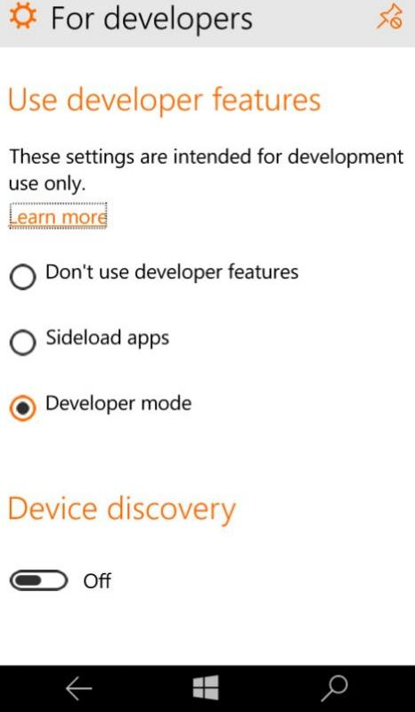
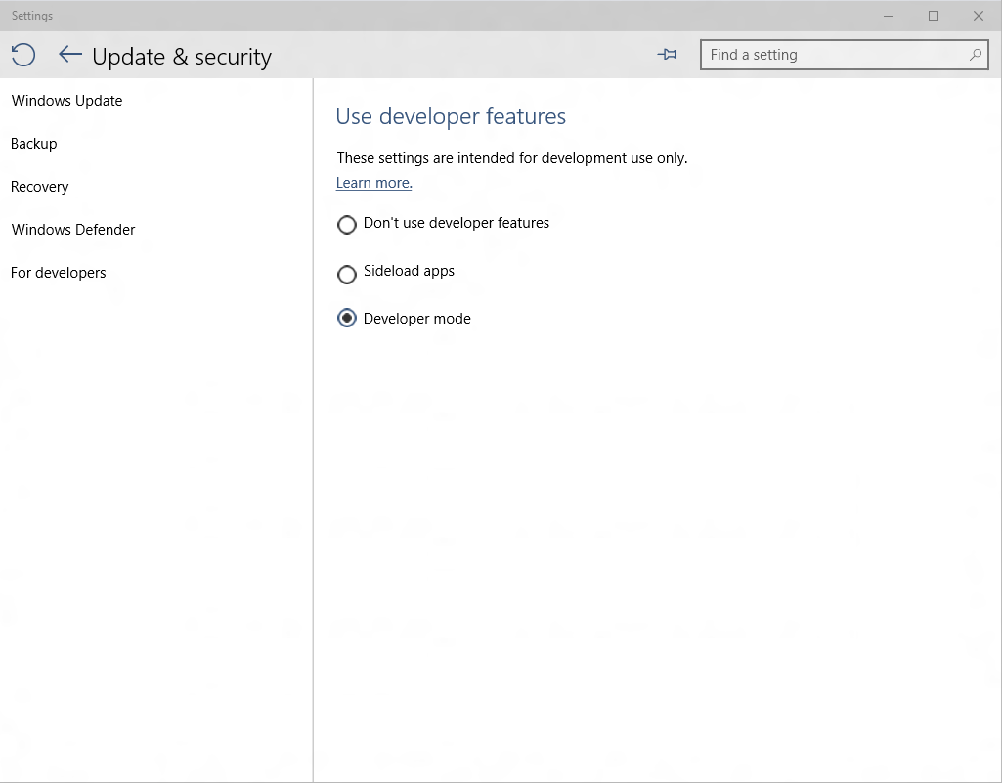
Developer unlock
Notes:
There is a different approach for development for Windows 10 devices. A developer license is no longer required for each device that you want to use to develop, install or test your app. You just enable a device once for these tasks from the settings for the device. That's it. No more renewing your developer licenses every 30 or 90 days!
You can easily developer unlock any Windows 10 PC/laptop/tablet or Phone just by going to System Settings to allow you to deploy apps to the device directly from Visual Studio and carry out on-device debugging and testing, or just for sideloading apps that have not been certified by the Windows Store.

Slide 45

Where can I develop?
Windows 10
Requires Visual Studio 2015
Windows 8.1 & Windows Server 2012 R2
The Visual Studio designer does not function
Debugging requires a Windows 10 device or Remote Debugging Tools
Notes:
Where can you do development?
Visual Studio 2015 and the Tools for Windows 10 can run on PCs running Windows 10, on PCs running Windows 8.1 and on Windows Server 2012 R2.
To get the best developer experience including full availability of tooling features such as the visual designer, you should use a machine running Windows 10.

Slide 46
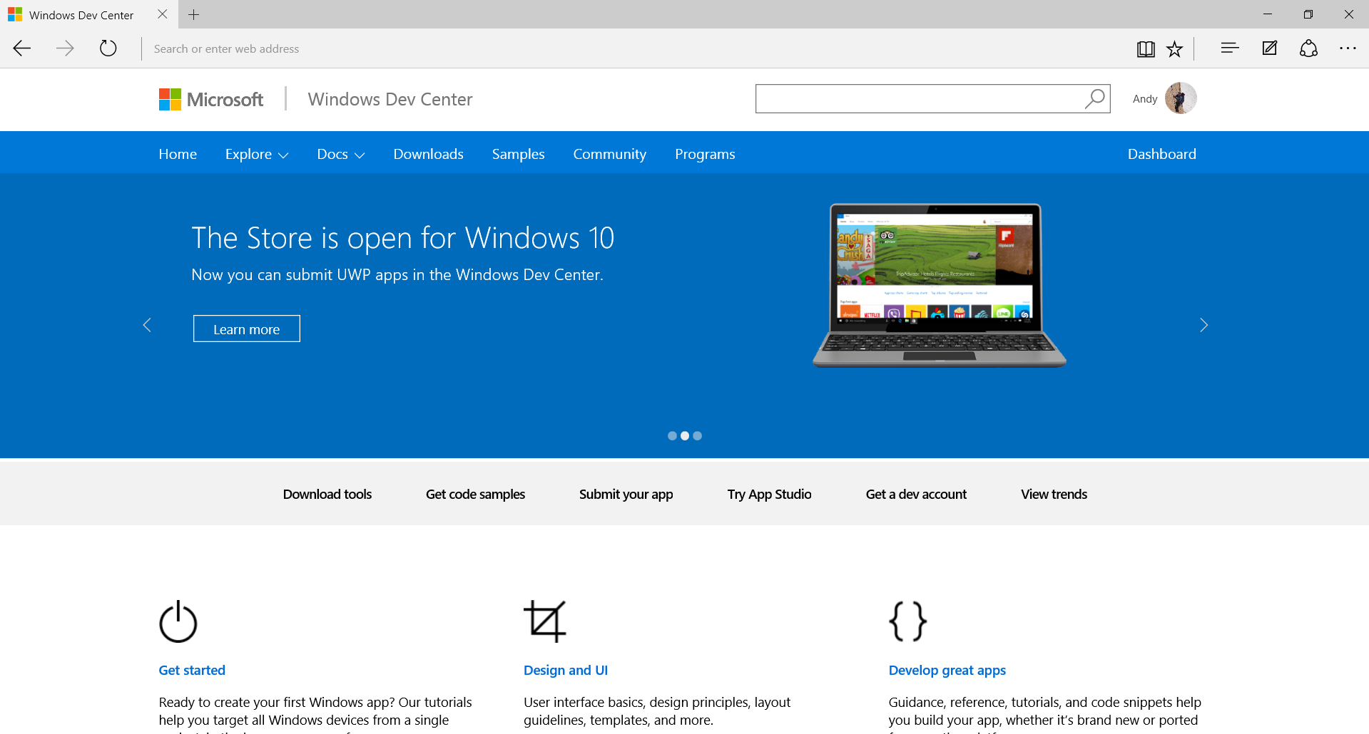
dev.windows.com
Notes:
Finally, for any questions on how to build apps for Windows 10, and for access to the Dev Center, or to take part in the forums, go to our home on the web: dev.windows.com.
Here you will find tutorials, samples, getting started guides and access to the full documentation.
Everything you need to help you create great UWP apps for Windows 10!

Slide 47
Introducing “Template 10”
A new blank template
Includes a few files & empty folders to guide conventions
Similar to the MVC template
Add-on components to solve common problems
Solving for the 90%
The code will solve the 90% use case
Delivering with Windows 10
The template is in GitHub and still under construction
Notes:
Templates are extensible, so MS isn’t sending them with VS any more.
Template 10 helps.

Slide 48
Contribute to Template10 http://aka.ms/template10

Slide 49
A single platform
One Windows
Many devices
Developer experience
Windows tooling
.Net Native
Template 10
http://aka.ms/template10

Slide 50
Other resources
Microsoft Virtual Academy
Windows Dev Camp https://github.com/Windows-Readiness/WinDevCamp

